Slide 1

Oakwood Fund Management

Slide 2

Why we are here
Present our student-run ESG investment fund.
Prove its value in educating students in practical finance.
Generate profits for charity.
Introduce our team.

Slide 3
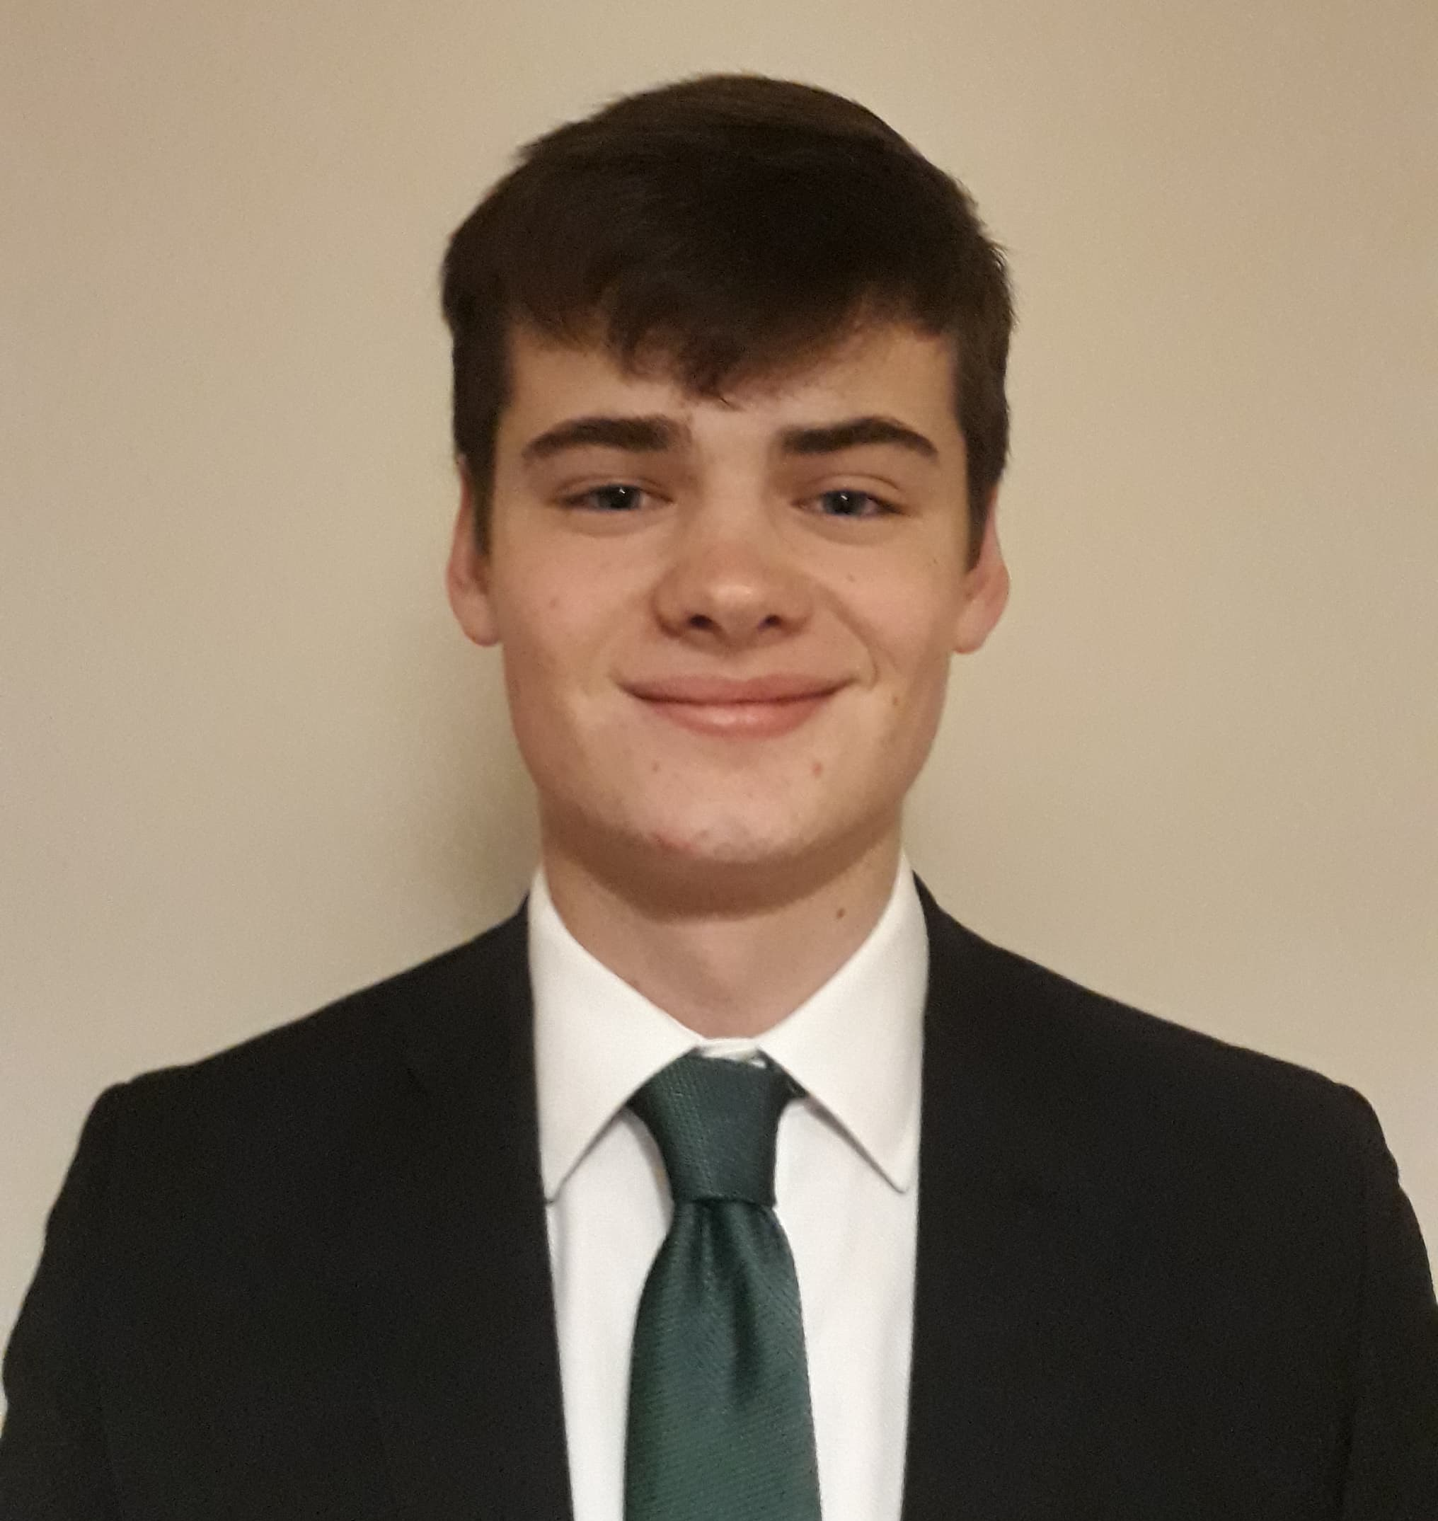

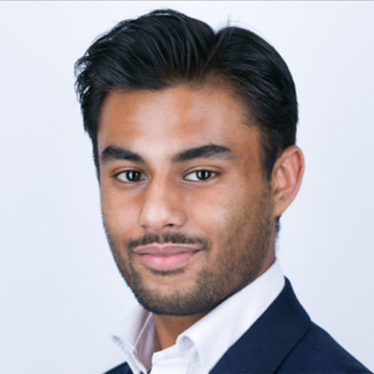

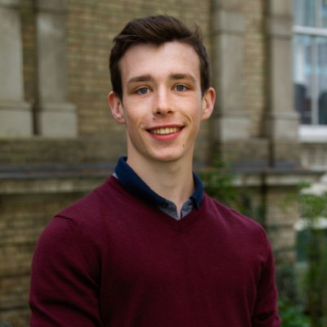
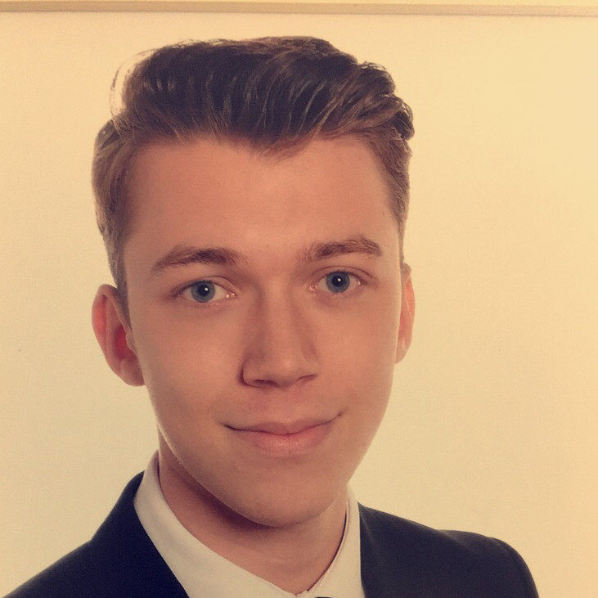
The Team
Sebastian Brennan | Michael Adegoke | Syed Bakht | Emilia Hurrell | Michael Prinz | Rowan Beswick
Managing Director | Head of Compliance | Director | Fundraising Director | Society President | Society Vice President
Faculty of Medicine and Health Sciences | Law Background & School of Economics | School of Economics | School of Mathematics | Norwich Business School | School of Mathematics
50 members from every academic background.
Experience in risk, compliance, operations & more.

Slide 4

Problem
“Over half of recruiters warn that graduates who have had no previous work experience are unlikely to be successful during the selection process and have little chance of receiving a job offer for graduate programs.”
High Fliers Graduate Market 2013 Survey

Slide 5
“Too many candidates are applying to jobs but clearly have no knowledge of how the industry or company works”.
Brian Hood, Head of Campus Recruitment at Citigroup Corporate and Investment Bank

Slide 6
Solution: Student-run investment fund
Gain vital experience – financial analysis, risk management & compliance, technical analysis, knowledge of markets, ESG investing.
Allow students to test theory.
Workshops on security analysis and trading for new members.
Instill values of charity and ethical investment.
“Hands-on trading experience helps graduates find investment jobs” Financial Times

Slide 7
How the Fund works
Investment Committee
Fund 'Directors'
Bond team
Financials team
Technology team
Advisory Board
ETF team
Commodities team
Risk & Compliance
Macro Report
ESG fund, ensures all investments are ethically sound.
At least 50% of profits from the fund will go towards charity, remainder reinvested.
The fund is not-for-profit meaning no member can withdraw cash.

Slide 8
ESG Screening
Products will be negatively screened against our minimum standards policy.
Products are then positively screened to recognise products that set an example for their underlying industry.
Managers will then debate and discuss each pitch. They select the best pitches to be delivered to the investment committee for approval.
Goals: aligning business practices with the Principles for Responsible Investments.

Slide 9
Market
Notable student funds in the UK:
Imperial College Business School - £100,000 AUM
Edinburgh University - £58,000 AUM
Queen Mary School of Economics - £40,000 AUM
Cambridge Clare College - £89,000 AUM
Proves this concept is possible.
Evidence to suggest universities with student run funds are more attractive to students.
“Business school-funded portfolios prove a draw for students and employers”
Financial Times

Slide 10
Competitive Advantage
ESG gives our fund an advantage over other student funds and even the market.
Funds held by University, attracting tax relief for donors.
Backed by finance industry experts.
Oakwood based in Norwich and not London like majority of other student funds, providing an untapped network of local partners in the finance sector.
Oakwood's governance structure and risk/compliance team ensure tighter regulatory monitoring of management.
“Majority of ESG funds outperform wider market” Financial Times

Slide 11

Investment Strategy
Global Macro, Multi-Asset, Long only
ESG driven.
Top Down asset allocation.
Quarterly Rebalance.
Investment Committee oversees decisions.
1+ Year Investment Horizon
Notes:
Asset allocation can be rebalanced to reflect market conditions

Slide 12
Fund Results
Over the last two years the society has conducted a virtual fund to simulate the operations of the real fund.
Despite the coronavirus stock market crash, the portfolio more than outperformed the FTSE100.

Slide 13
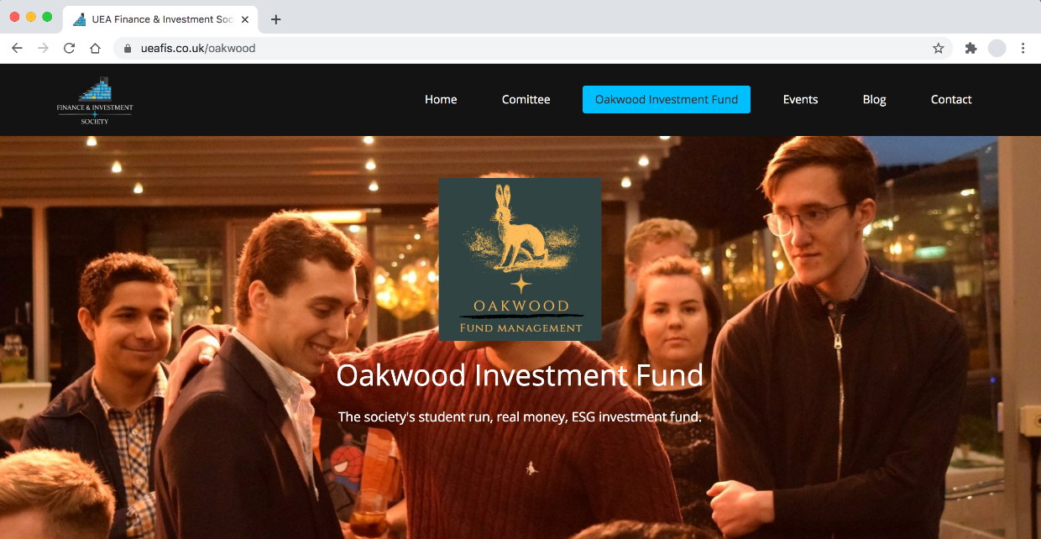
Social Media Presence
How you can use our platform to promote your organisation.
New website.
500+ views every month on LinkedIn.
40% of visitors from finance sector.
Twitter presence.
Network opportunities through FISLA
and alliances with other university
funds.

Slide 14
Why donate?
Ensure UEA becomes a top choice for Finance Undergraduates.
Support local charities and UEA's The Difference Campaign.
Improve employment prospects for finance graduates.
Invest in an ESG future.
Strengthen and re-unite a network of UEA Finance Graduates.
Potential seat on the Investment Committee.
Corporate Branding.

